Slide 1
Here is a suggestion: "AI Methods and Applications".

Slide 2
"What is Artificial Intelligence?
The report provides an accessible, scientifically and technologically accurate portrayal of the current state of AI and its potential.

Slide 3
Transportation
Artificial Intelligence (AI) is a technology that has been around for decades, but it has only recently become a part of everyday life. AI is being used in a variety of fields, including transportation, healthcare, finance, and more.

Slide 4
Healthcare
The potential for artificial intelligence (AI) to transform society is vast, but it will not be realized without overcoming significant challenges.

Slide 5
"AI in the City"
Artificial intelligence (AI) is a rapidly evolving technology that has the potential to transform many aspects of society, including healthcare, education, and public safety and security. In the next 15 years, AI is expected to play an increasingly important role in these fields, with applications ranging from intelligent tutoring systems to predictive policing. However, there are still challenges to be addressed, such as how to best integrate human interaction with AI technologies and how to ensure that AI is used ethically and responsibly.

Slide 6
AI and Policing
The report also highlights the potential risks of AIdriven policing, including the potential for oversurveillance, the potential for abuse of power, and the potential for the technology to be used to discriminate against certain groups.

Slide 7
Here is a very short title for the paragraph provided:
"AI and the Future of Work"
The impact of artificial intelligence (AI) on the labour market is difficult to predict, but it is likely to have a significant effect on the demand for certain skills and jobs. AI will likely replace routine tasks rather than jobs in the near term, but it could also create new kinds of jobs. The new jobs that emerge may be harder to imagine in advance than the existing jobs that are likely to be lost. Changes in employment usually happen gradually, often without a sharp transition, a trend likely to continue as AI slowly moves into the workplace.

Slide 8
Here is a suggestion:
Entertaining AI
The explosive growth of the internet over the past fifteen years has changed the way people interact, communicate, and entertain themselves. As a result, AI has become an integral part of entertainment.

Slide 9
"AI and Society"
Artificial intelligence (AI) is a branch of computer science that studies the creation of intelligent machines that can think and act like humans. AI is a very broad field, covering everything from expert systems to neural networks to genetic algorithms.

Slide 10
"AI in the real world"
The artificial intelligence (AI) revolution is finally delivering reallife benefits to earlyadopting companies.

Slide 11
The text discusses the potential of artificial intelligence (AI) to transform businesses and how early evidence suggests that there is a strong business case for its use across operations and within core functions. The text also talks about the growth of the AI market worldwide and how it is expected to reach an estimated size of $2.4 billion by 2025.
The global artificial intelligence market is expected to grow from $39.9 billion in 2021 to $91.5 billion by 2025.

Slide 12
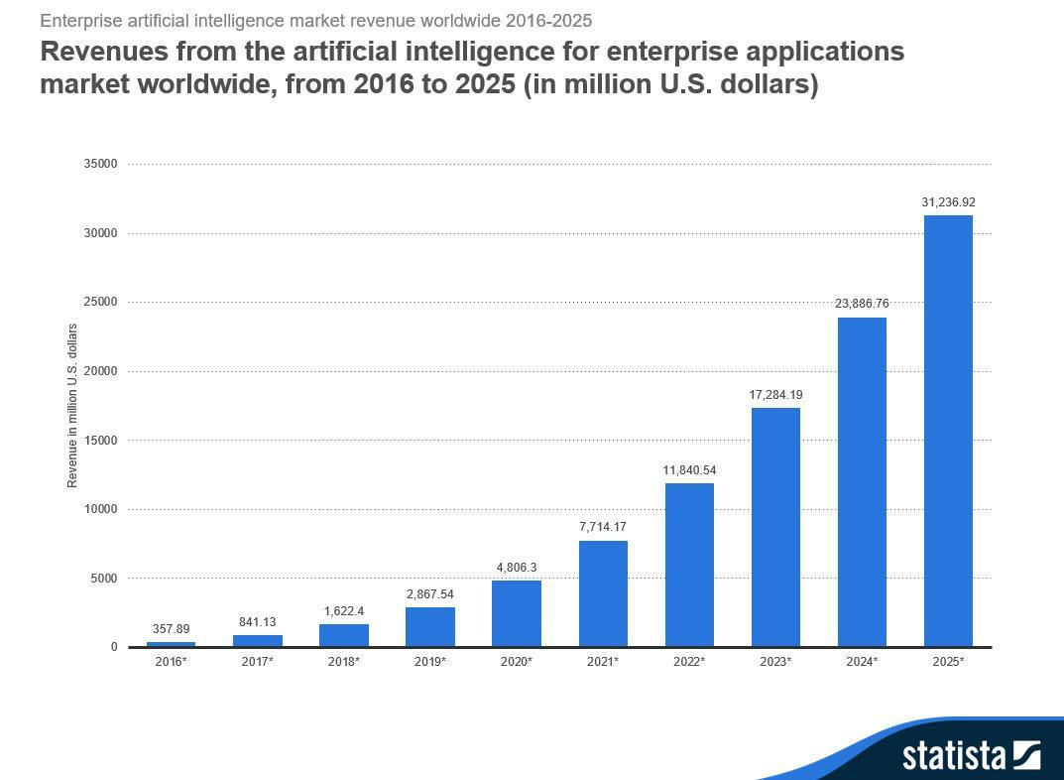

Slide 13
Here is a suggestion: "AI: The Next Great Technological Shift"
Artificial intelligence (AI) is the simulation of human intelligence processes by computer systems. These processes include learning (the acquisition of information and rules for using the information), reasoning (using the rules to reach approximate or definite conclusions), and selfcorrection. AI research is divided into subfields that focus on specific problems or approaches, such as computer vision, natural language processing, and decisionmaking.

Slide 14
Here's a suggestion: "AI Safety: It's in the name"
The paper discusses the nature of artificial intelligence and the risks associated with it. It also talks about the need for a global body to regulate AI research.

